Slide 1
Healing Music
-あああ-

Slide 2
Healing Music
-あああ-

Slide 3
Healing Music
-あああ-

Slide 4
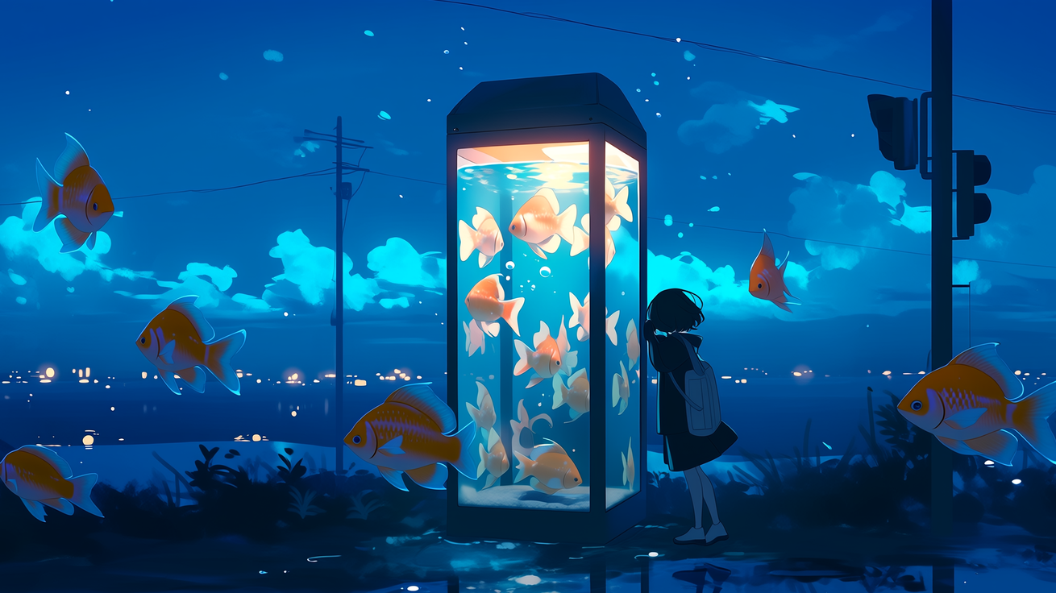
Healing Music
-あああ-

Slide 5

Healing Music
-あああ-

Slide 6
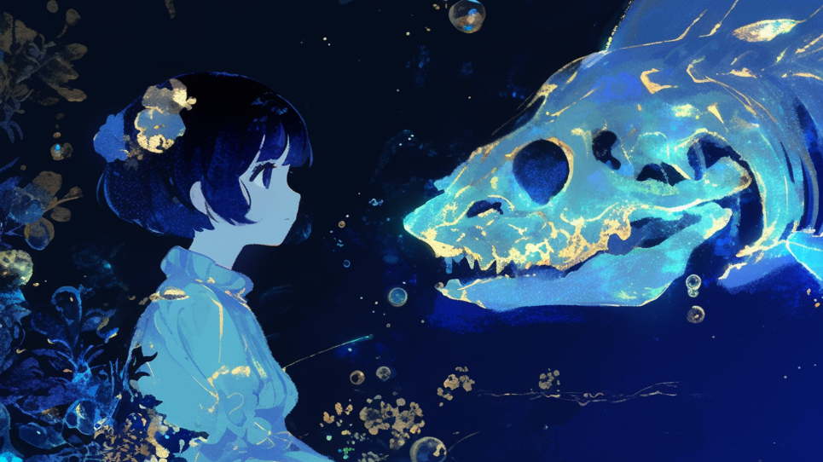
Healing Music
-あああ-

Slide 7
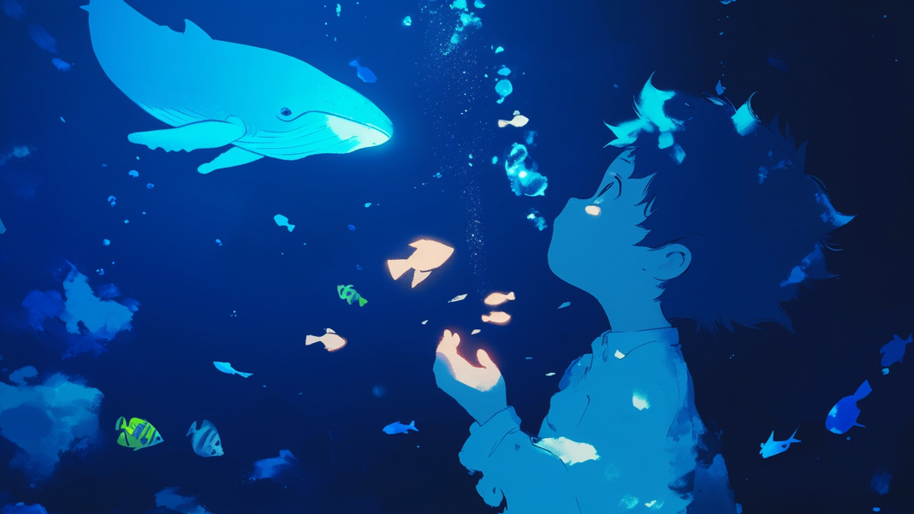
Healing Music
-あああ-

Slide 8

Healing Music
-あああ-

Slide 9
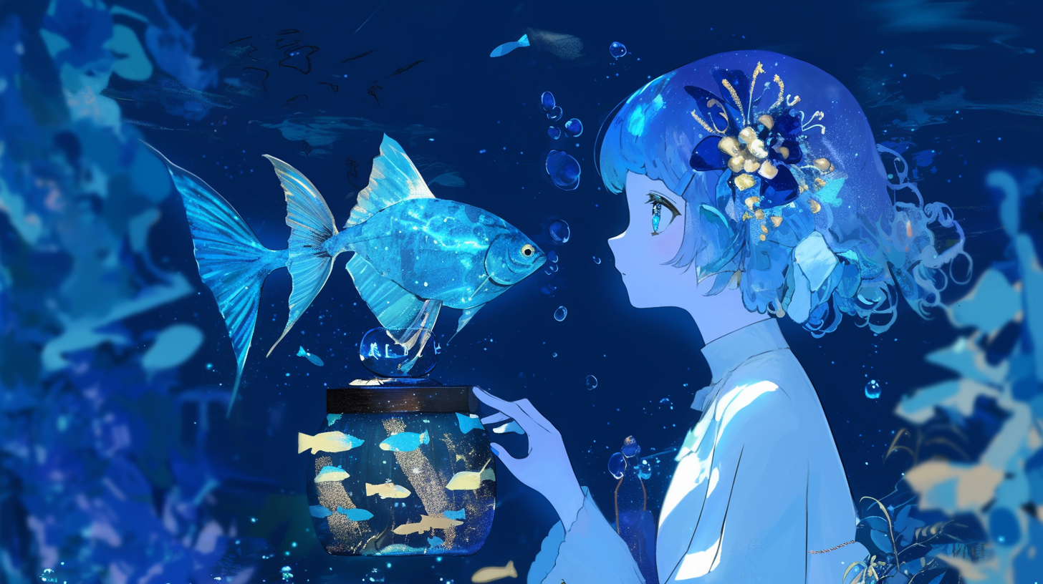
Healing Music
-あああ-

Slide 10
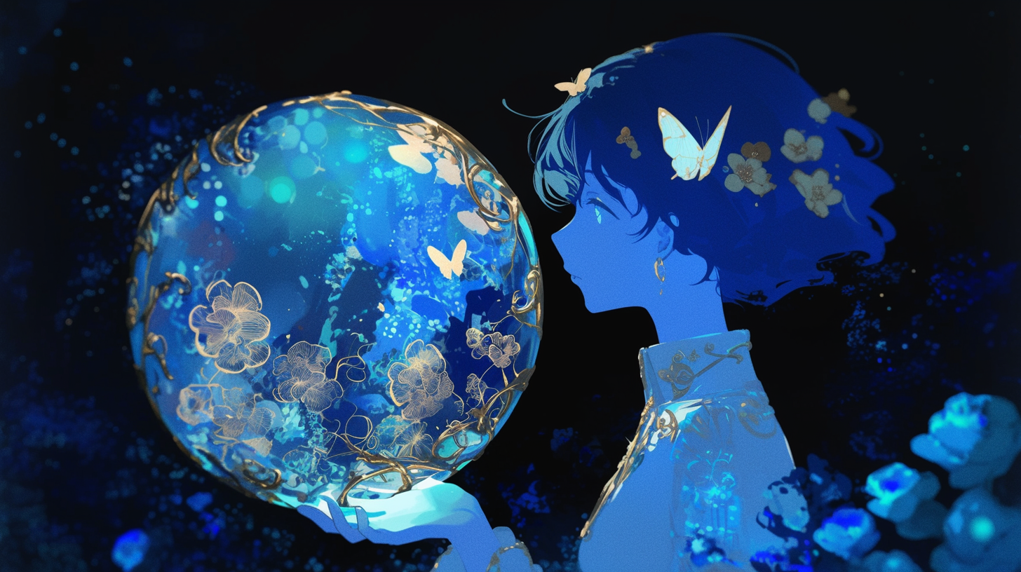
Healing Music
-あああ-

Slide 11

Healing Music
-あああ-

Slide 12
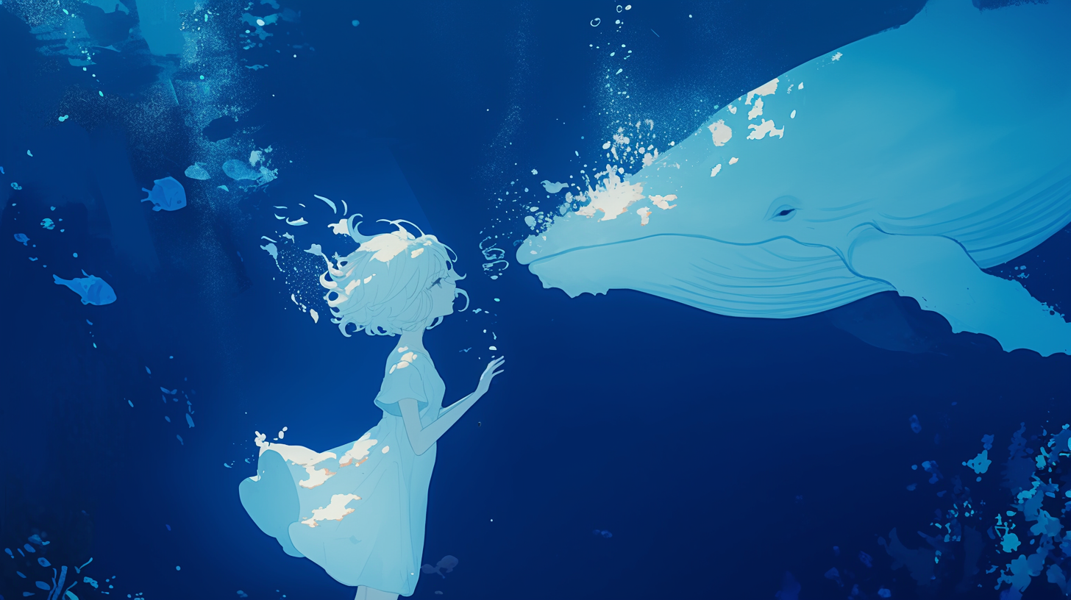
Healing Music
-白鯨の-

Slide 13
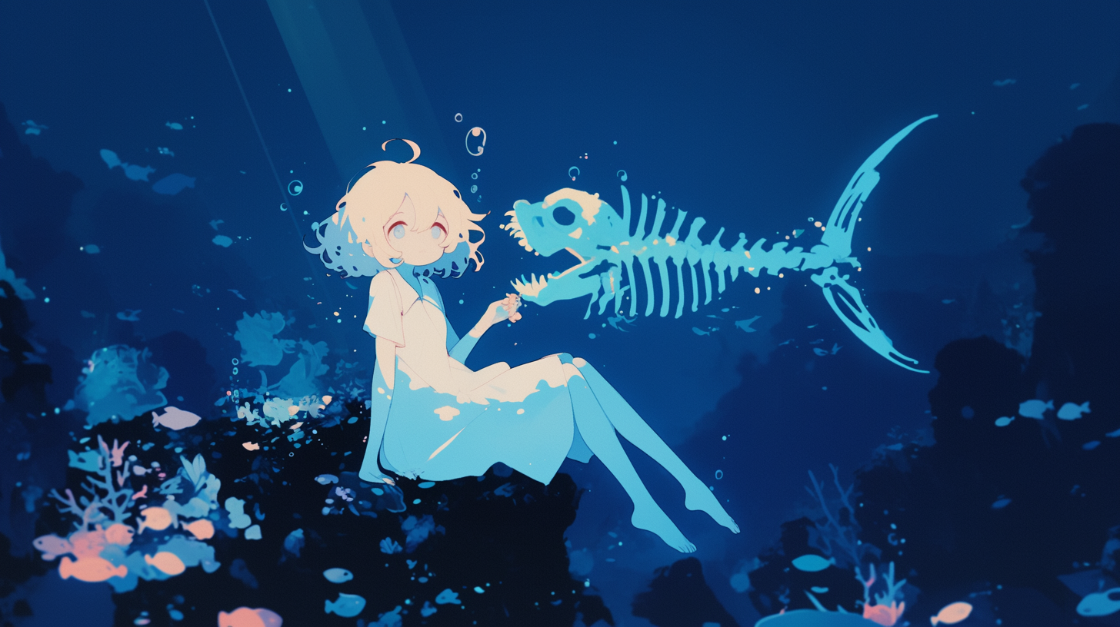
Healing Music
-あああ-

Slide 14
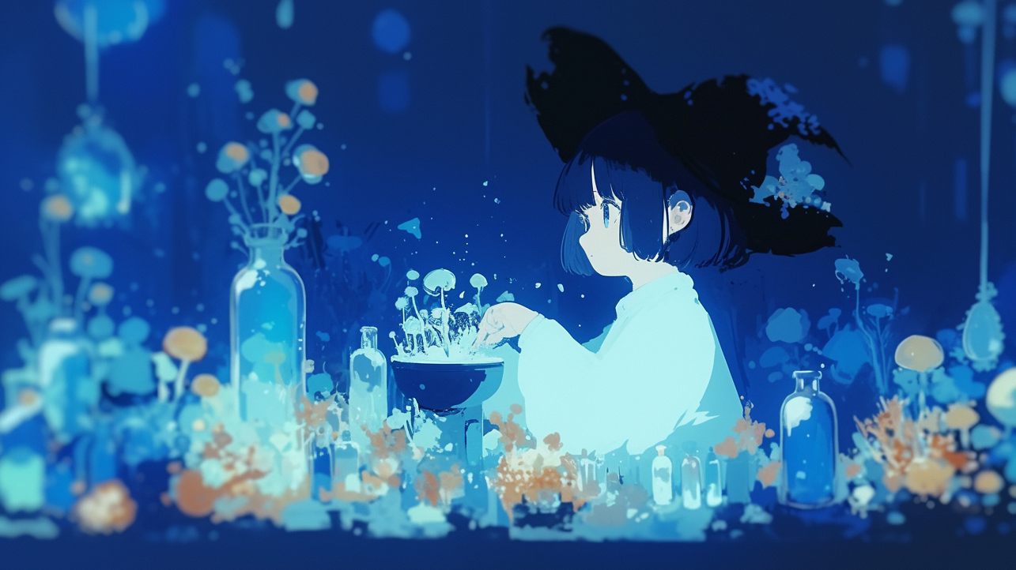
Healing Music
-あああ-

Slide 15
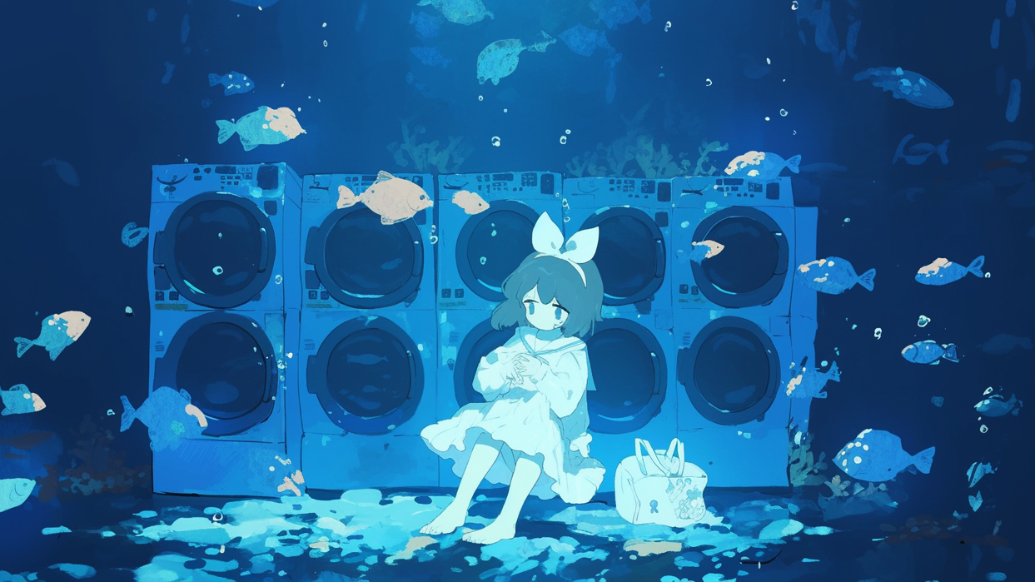
Healing Music
-あああ-

Slide 16

Healing Music
-あああ-

Slide 17
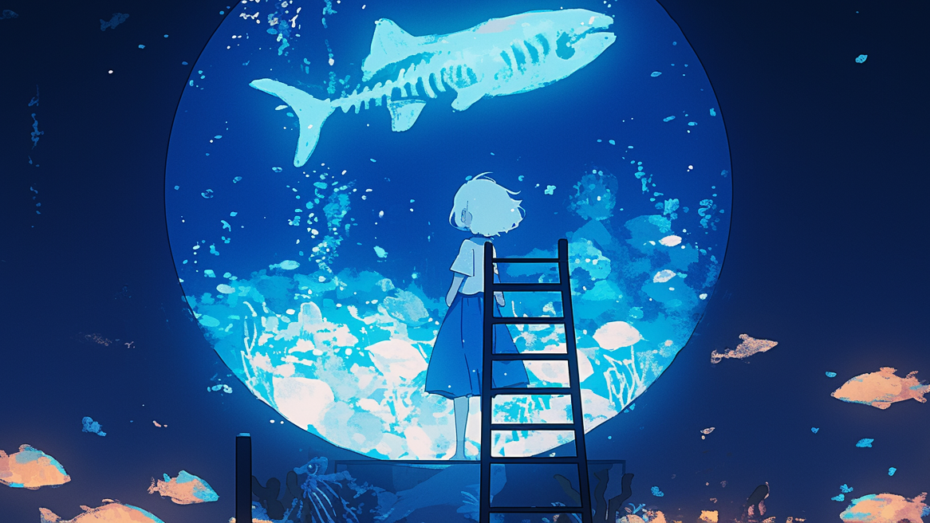
Healing Music
-あああ-

Slide 18

Healing Music
-あああ-

Slide 19
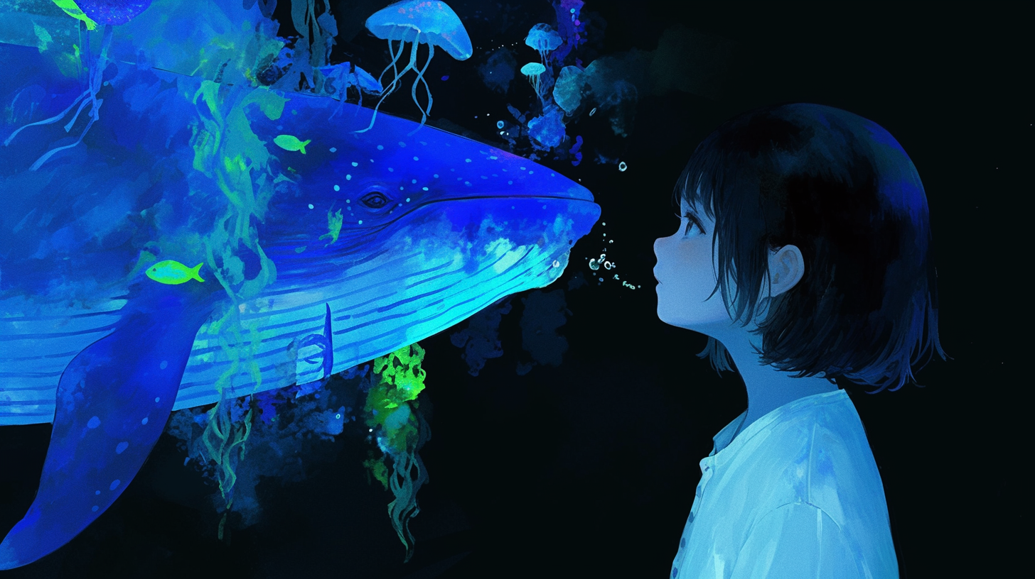
Healing Music
-あああ-

Slide 20
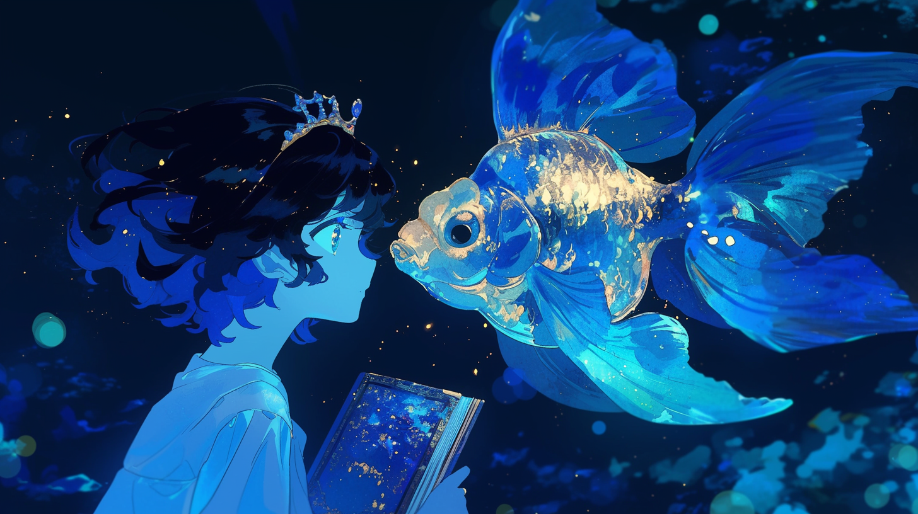
Healing Music
-あああ-

Slide 21
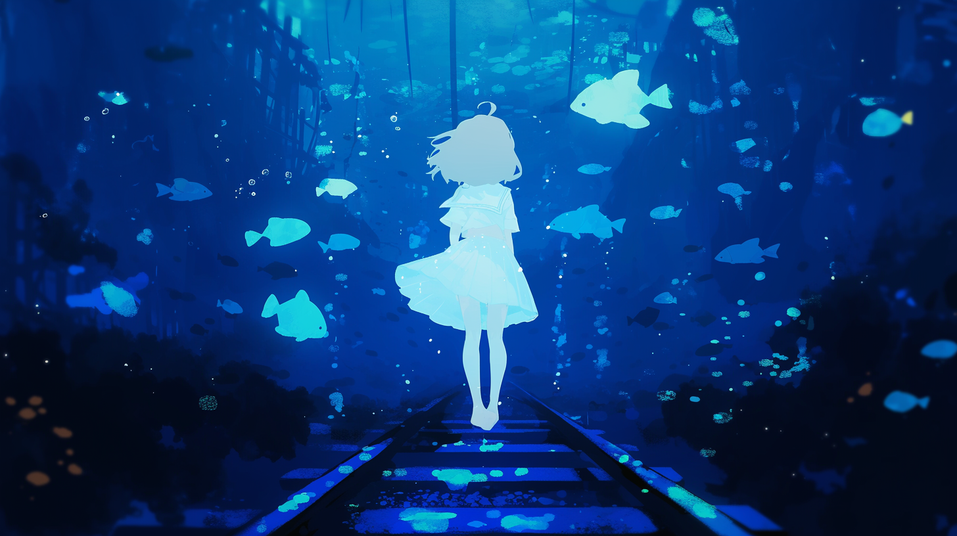
Healing Music
-あああ-

Slide 22
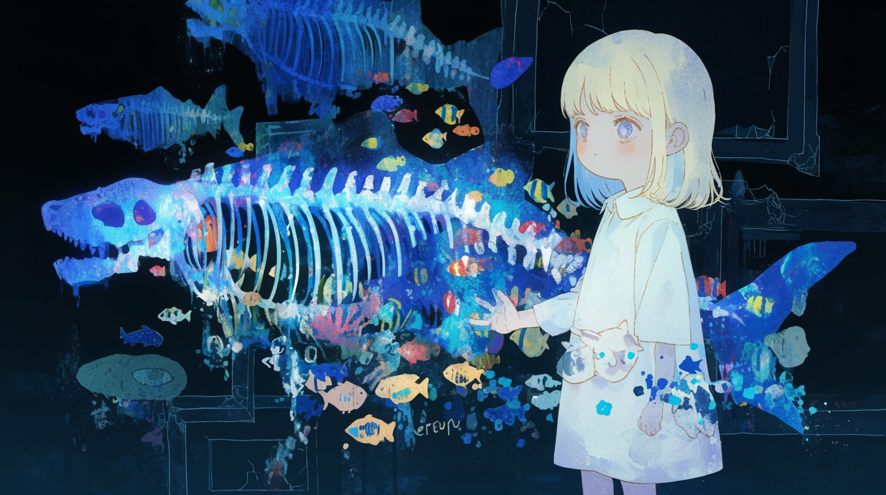
Healing Music
-あああ-

Slide 23
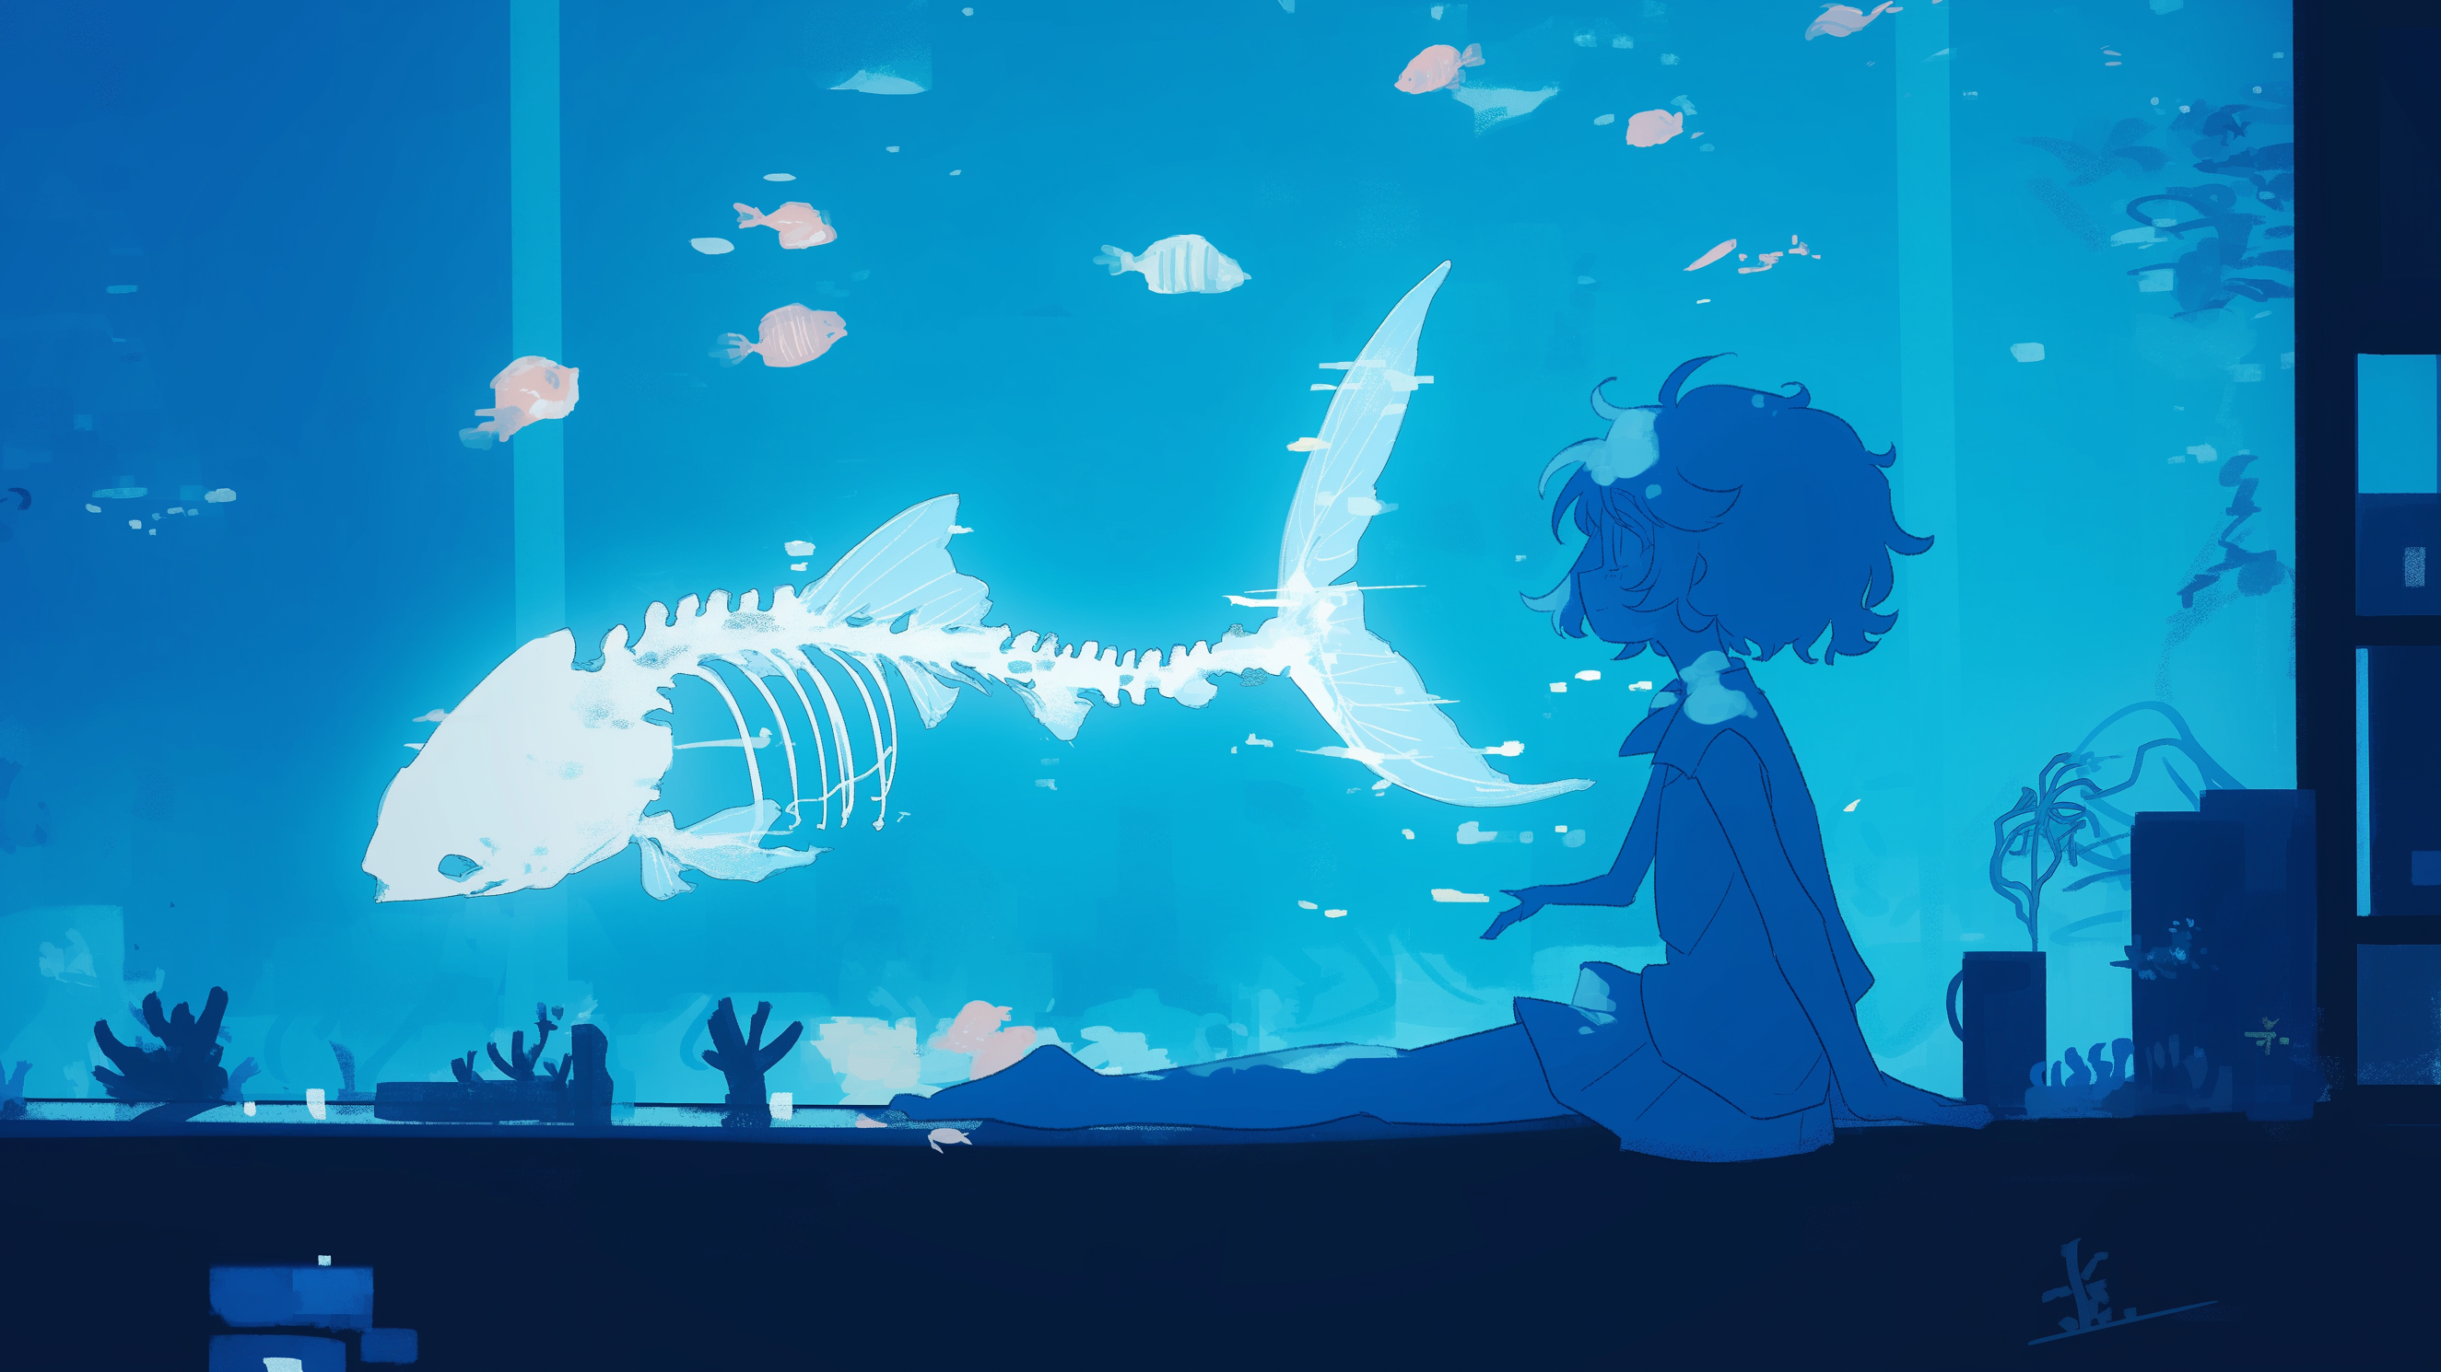
Healing Music
-あああ-

Slide 24

Healing Music
-あああ-

Slide 25
Healing Music
-あああ-

Slide 26
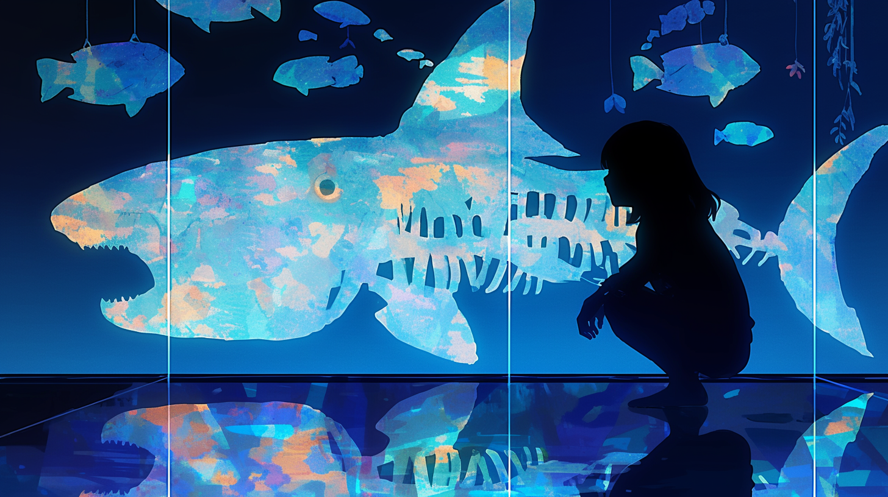
Healing Music
-古代魚と眠る夜-

Slide 27
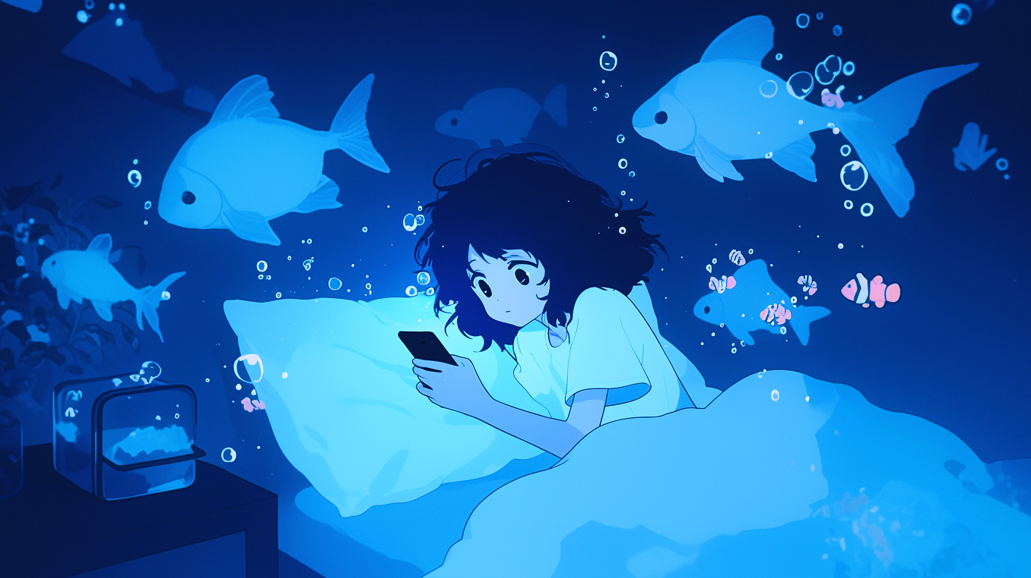
Healing Music
-眠れない夜の航海-

Slide 28
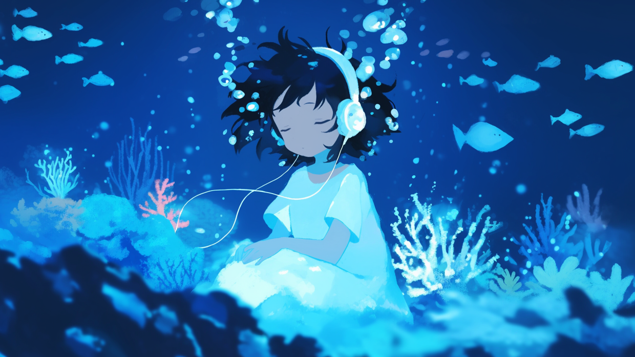
Healing Music
-静寂をなぞる泡音-

Slide 29
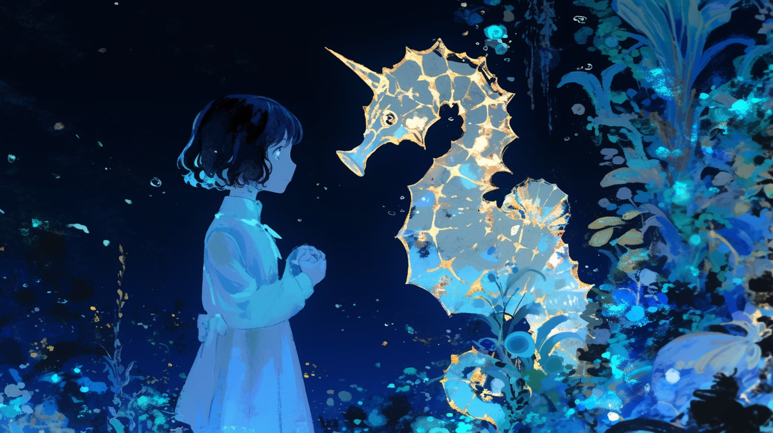
Healing Music
-蒼き深淵の底-

Slide 30
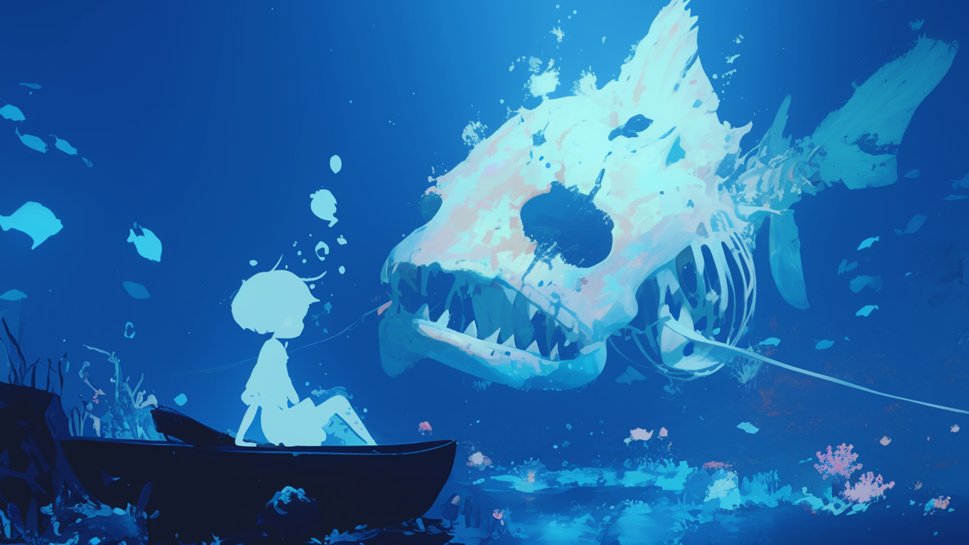
Healing Music
-忘れられた海域-

Slide 31
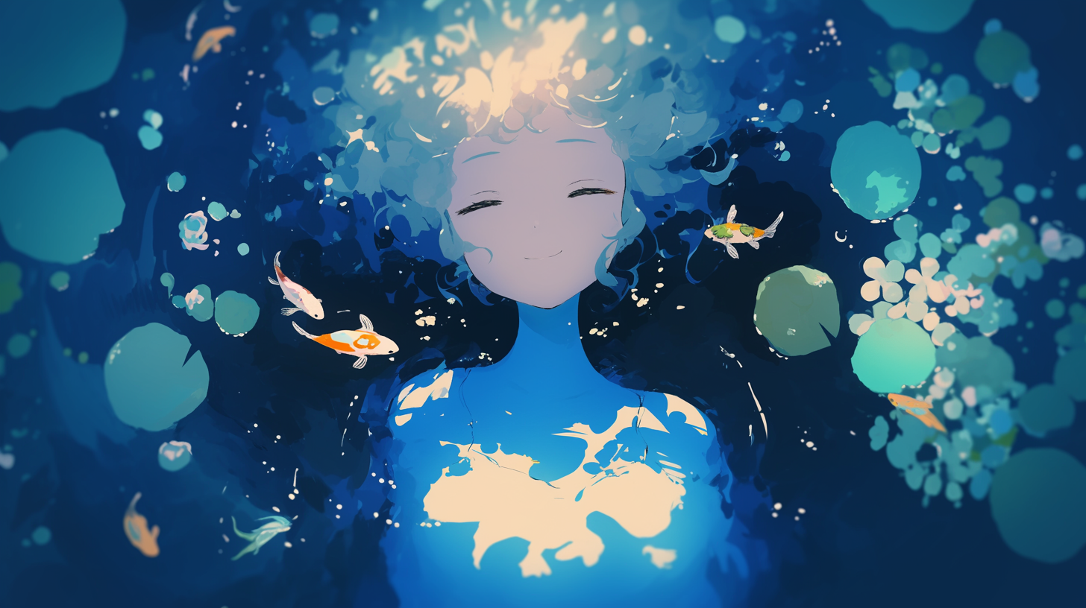
Healing Music
-水に溶ける微睡み-

Slide 32
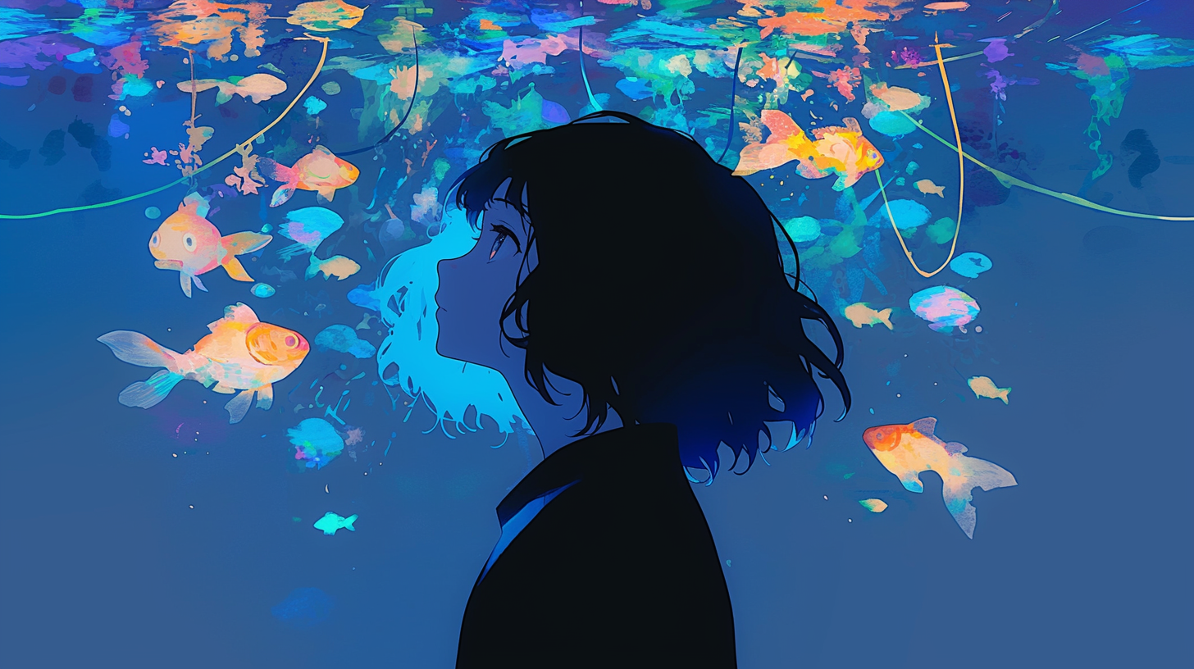
Healing Music
-凪の海と熱帯魚-

